Slide 1
SUPERSTORE ANALYSIS A detail analysis of superstore performance done by Vivek mohan

Slide 2
Table of contents Case Study----------------------------------03 Dataset Information----------------------04 ETL--------------------------------------------05 Data Modelling -----------------------------06 Analysis--------------------------------------07 to 11 Conclusions---------------------------------12

Slide 3
Case Study
A superstore retail business is a large, multi-department store that sells various products, including groceries, electronics, home goods, clothing, and more. These stores are often designed to be a one-stop shop for customers, offering a wide range of products and services under one roof. Superstores are typically larger than traditional retail stores and may have a larger product selection. Superstores are often part of a larger chain and have multiple locations in a region or country.
A new store manager needs the help to better understand his Data Operations Team. Provided with part of the sales data that a Business Intelligence Analyst encounters daily. An Appropriate dashboard should be designed to analyze and interpret the data to help provide valuable insights to the store manager.

Slide 4
Dataset
The retail sales data includes information on orders placed by customers, the products ordered, and the shipping and delivery details. The dataset contains 9994 records and 17 columns, including categorical variables such as product category, sub-category, customer segment, and shipping mode, as well as numerical variables such as quantity, price, and sales.

Slide 5
ETL
The data coming from the source is in raw form in the flat file, hence cleaned and transformed the dataset for efficient use.
Deleted the empty columns and rows.
Changed the fields to appropriate data types.
Split the fields and renamed the columns appropriately.
Standardized the values in the column Ship mode [Replaced FC with first class]
Split the address column to City, State, Country and Pin-code.

Slide 6
Data Modeling
Tracking sales in the retail business is a weekly task, hence setting up the data model will be crucial for this. Converted a flat file into STAR schema for better performance of the analysis.
The schema shall have a central Fact table, ‘Orders’ and three dimension tables, ’Order details’, ‘Customer’ and ‘Product’.
Removed duplicate rows from the newly created dimension tables, and ensured there are no empty rows
one- to - many relationships are created between dimensions and fact table.

Slide 7
Data Analysis
Furthermore, to grow the footholds in the store and achieve an ambitious sales target, the store manager wanted to track and visualize the following metrics;
1. Created a new column ‘Sales’ or ‘Order value’. Created a card visual displaying the total sales.
2. Similarly calculated the Sales from discounted products and displayed the total sales from discounted products.
3. Since supermarkets sell bulk items, store managers wanted to know each order's cart value.
Created a column “Cart Value” that categorizes the order value/sales as Low, medium, high or very high.
Cart Value,
< 1000: Low
<3500: Medium
< 10000: High
> 10000: Very High

Slide 8
4. Separately made the visualization for the total sales just from the low cart value category (as mentioned, any value below 1000 can be considered as low value category).
5. Using card visual, tracked the total sales coming from the low cart category and discount more than or equal to 50% to find out the contribution and cause.
Found out the number of days it takes to deliver for each shipment type (ship mode) so that delivery issues can be looked at on priority. Created a column chart that shows the average number of days it takes to deliver for each shipment type.
7. In the Retail business, do we see a spike in sales on special occasions like festivals? To achieve this, created a matrix visualization that displays order date as hierarchy , sales and sales year to date.
Visualized the cumulative sales for each month for all the years to calculate Year on Year Sales Growth.
Calculated YoY growth.

Slide 9
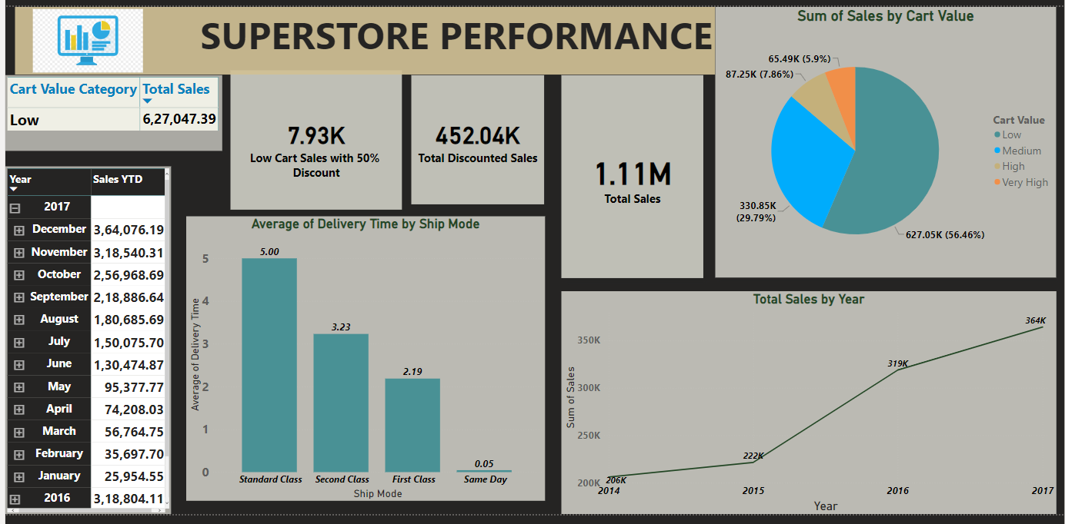

Slide 10
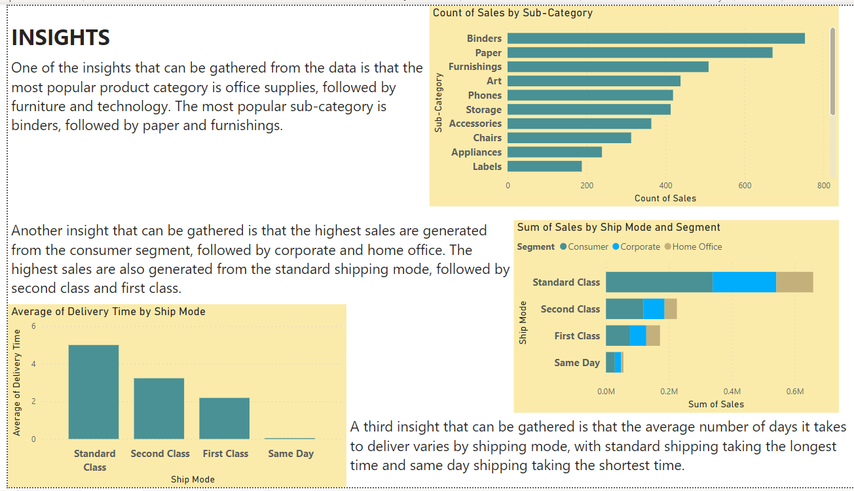

Slide 11
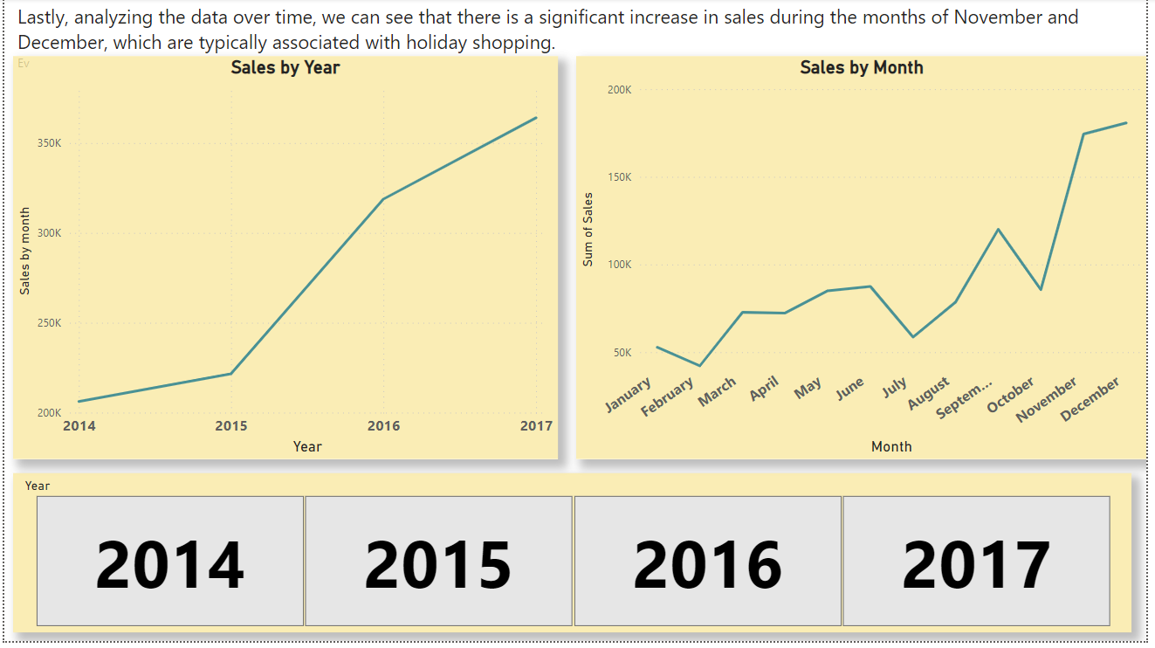

Slide 12
Conclusion After ETL and Data Modelling ,the cleaned data contains 5009 records and 24 columns, as few columns had been split and few of the new columns were added. The superstore data has provided valuable insights into product popularity, customer segments, shipping modes, delivery times, and sales trends over time. The analysis has also given insights for the top popular categories & their respective sub categories and vice-versa. This analysis was also helpful in order to grow the productions and sales in particular months. Overall analysis will definitely help in further decision makings for the betterment of the superstore business and its performance.

